Slide 1

SDZWA Sensor Dashboard
Project Update
May 5, 2022

Slide 2
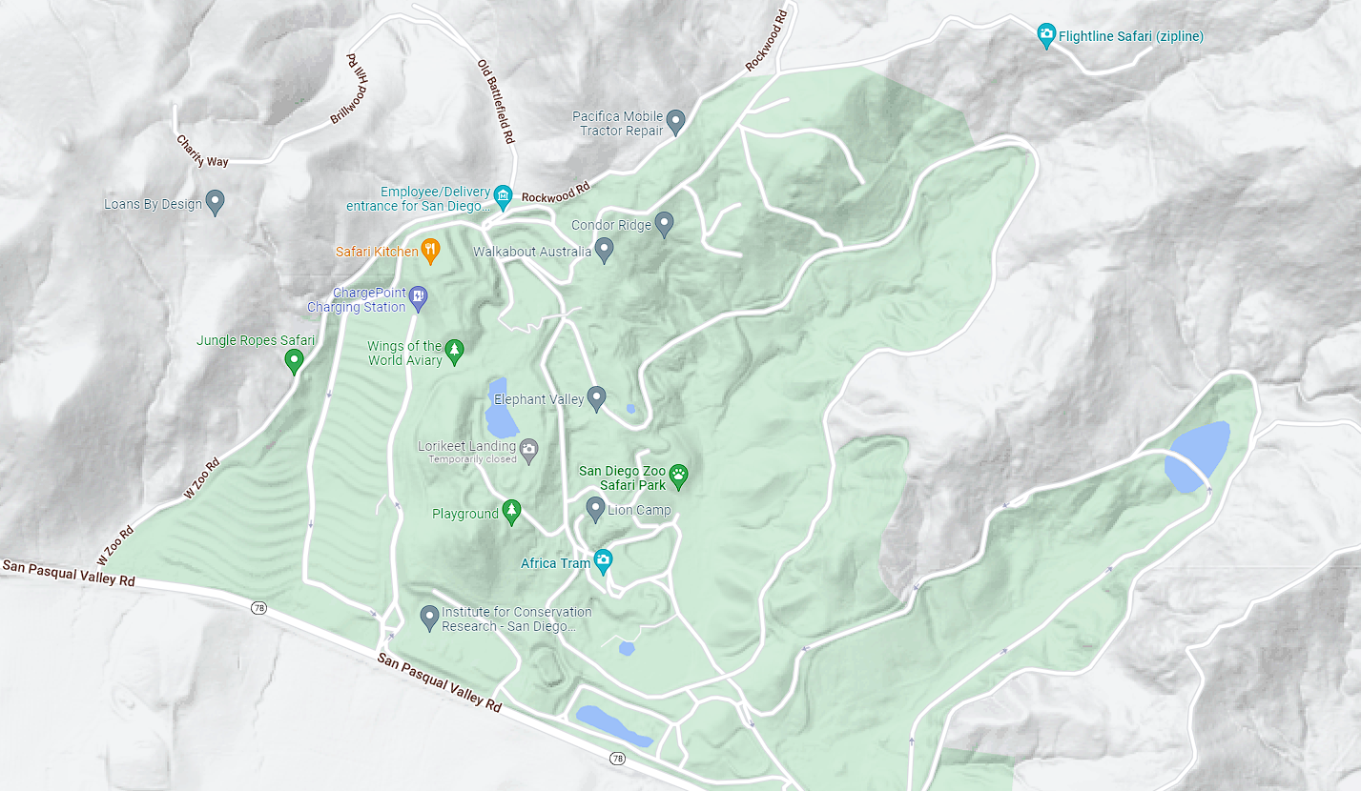
Motivation
Researchers at the Zoo manage a variety of sensors including IP cameras, weather stations, and microphones.
There is currently no centralized method of collection, storage, or visualization of data from these sensors.
San Diego Zoo Safari Park covers 1,800 acres.
Notes:
The San Diego Zoo and Wildlife Alliance maintains large amounts of land, hosting over 3,500 animals.
Need an interface to manage and monitor the health of these sensors.

Slide 3
Project Overview
Web application that can help researchers view and manage a tile dashboard displaying audio, video, and numerical data from various sensors in the San Diego Zoo Wildlife Alliance

Slide 4
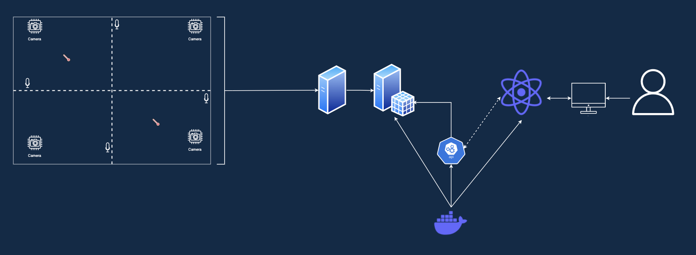
Big Picture
Database
Web App
Local Data Store
Device
User
APIs
Zoo Sensor Network
Deployment

Slide 5
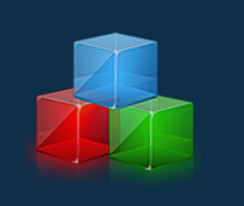


Front End Design Choices
Modular
Customizable
Flexible

Slide 6
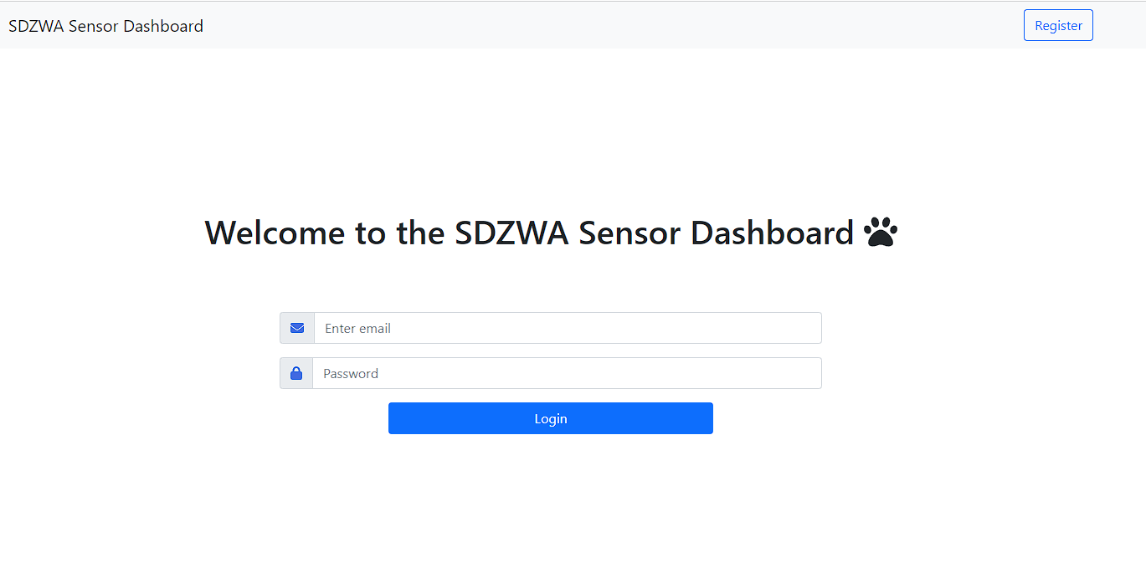
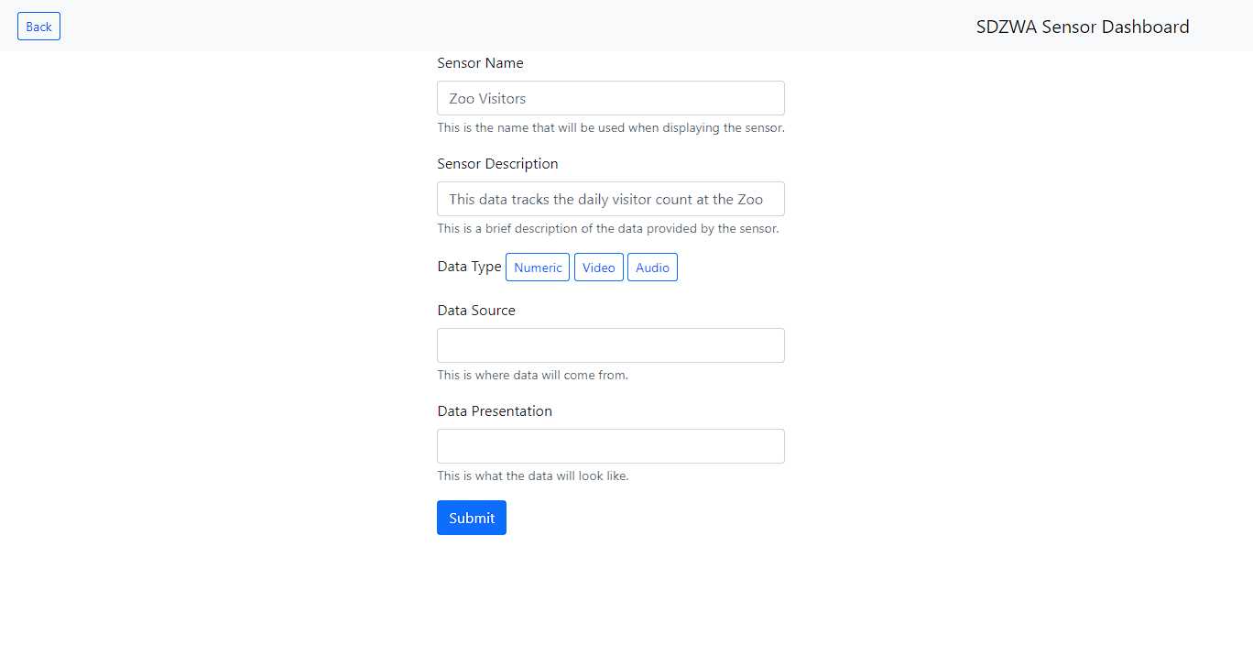
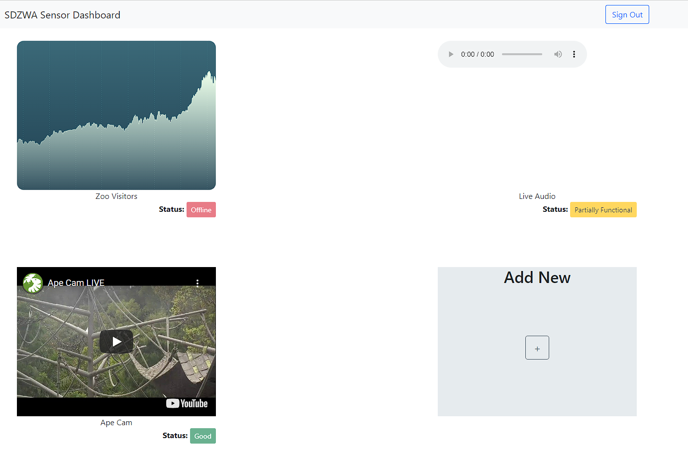
Front End Product

Slide 7
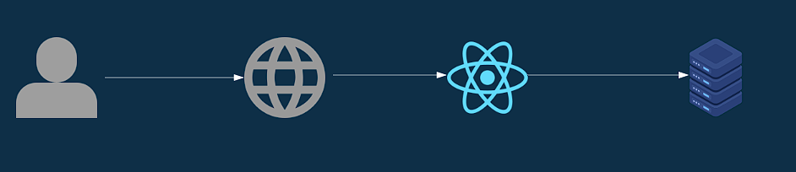
Front End Data Flow
→Login/Register
→Sensor Operations
(View/Add/Edit/Delete)
Process User Action
API Call
User
Browser
React Web App
Database

Slide 8
Back End Design Choices
✅ Availability
✅ Simplicity
✅ Security
Notes:
Akshaya

Slide 9
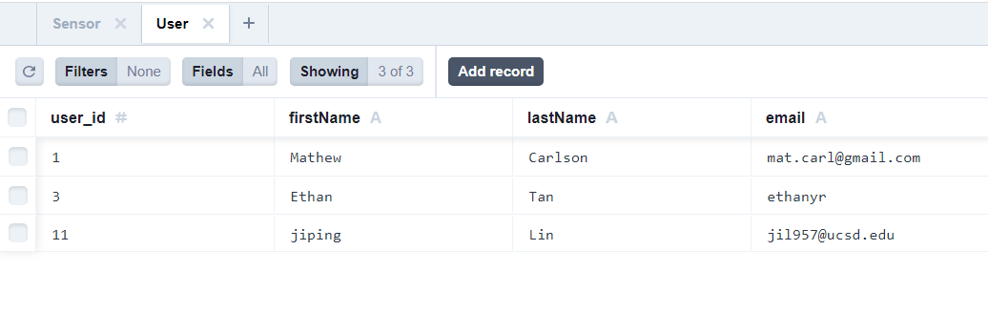
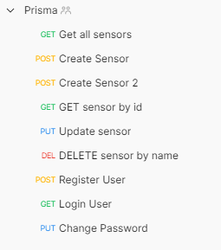
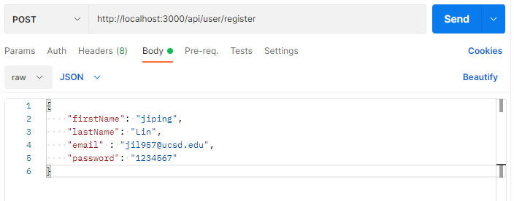
Back End Product
Notes:
Jiping

Slide 10



Back End Implementation
Migrate schema
REST API
Object Relationship Manager (ORM) for our database
SQLite local datastore
Frontend Web App
Node.js server (Docker support)
*Images are referenced from Google
Notes:
Ethan

Slide 11
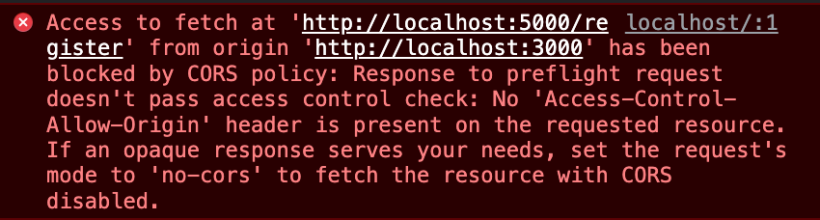
Difficulties Faced
Integration
2. Access to Sensors
3. Data collection

Slide 12
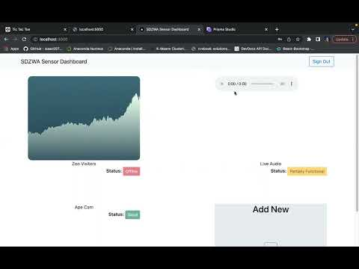

Demos
https://youtu.be/5arP-vqsUQU

Slide 13
Wrapping up
MVP
Quarter Accomplishments
Common
App functional without internet
HTTPS for communication
Frontend
Handle multiple input types and sources
Multiple visualizations (video player, line/bar/gauge graph)
User authentication
Backend
Sensor metadata schema
Online database for admin
Server functionality for editing database using REST
Docker environment for hosting service
Functional Web App
Displays audio, video, numerical data
Tile Dashboard for ease of use
Customization features for sensor tiles / pages
Secure Database for sensor and user data
API functionality for backend → frontend communication (authentication)

